Slide 1

COMPARING SEVERAL METHODS OF REINFORCEMENT LEARNING IN SOLVING A COMPLEX MAZE
Li Meng S2651513
Mega Bagus Herlambang P279285
Yuying Chen S3421902
Zhuoyun Kan S3346935

Slide 2
What to learn from this project?
Learning from maze with unknown content by reinforcement learning

Slide 3
What is reinforcement learning?
“In reinforcement learning, the learner is a decision-making agent that takes actions in an environment and receives reward (or penalty) for its actions in trying to solve a problem.” (Alpaydin, 2014, p. 517)

Slide 4
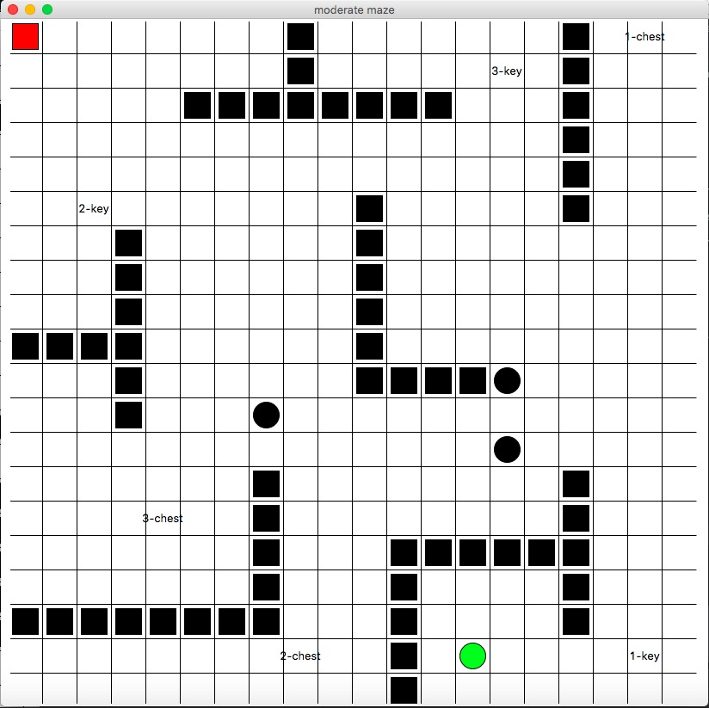
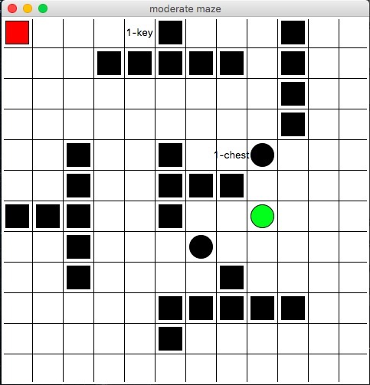
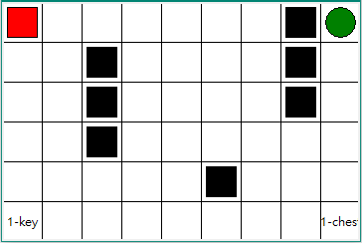
The maze
To compare performances with different algorithms, different kinds of mazes are designed
Elements in the maze:
Walls (-)
Pits (-)
Pairwise keys -> chests (+)
Exit (+)

Slide 5

The maze
State:
Agent in the maze
(0, 0)
And with key, chest, etc.
Actions of the agent
(Up, down, left, right)
Reward:
Walls (-)
Pits (-)
Pairwise keys (0) -> chests (+)
Exit (+)

Slide 6
Goal & rules
Can not go through the fixed walls
Get maximal rewards in shortest path
Find the key → open the chest → exit ☺
Have punishment when stepping into the pits ☹

Slide 7
algorithms
1. Basic algorithms:
2. Algorithms with lambda:
Q-learning
Sarsa
Q-lambda
Sarsa-lambda
QV-lambda
Indicators
Maximal rewards to obtian
Steps to solve the maze

Slide 8
Experiment Setup
Complexity of maze:
Walls, pits, key-chest, exit, size
Total steps:
learning before consuming all steps
Max steps:
Max number to move in each epoch
Learning parameters:
Reward gamma, learning rate, greedy rate,

Slide 9
Results

Slide 10
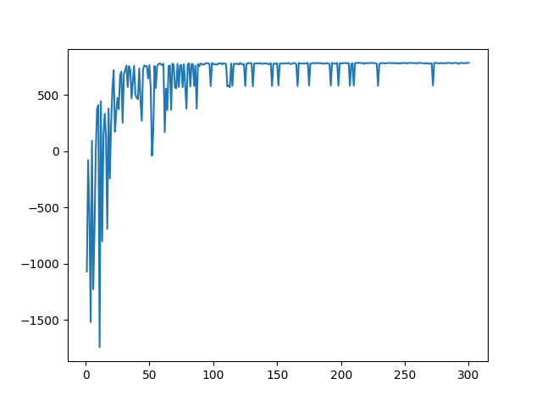
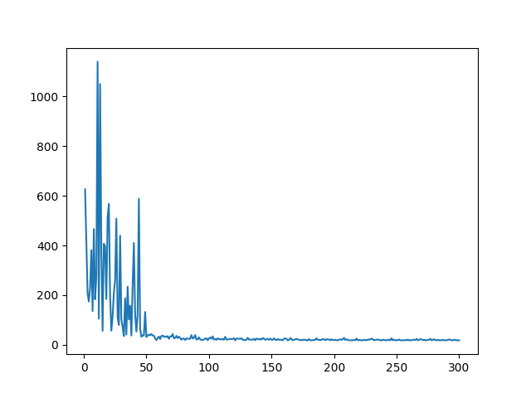
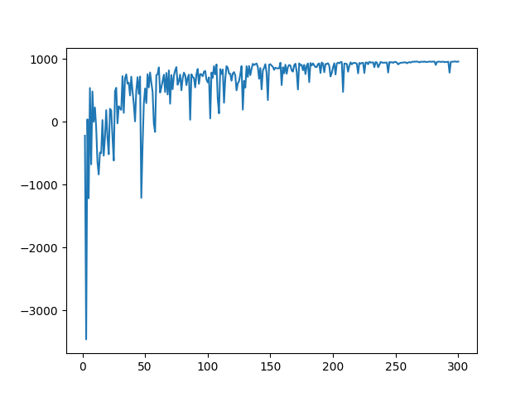
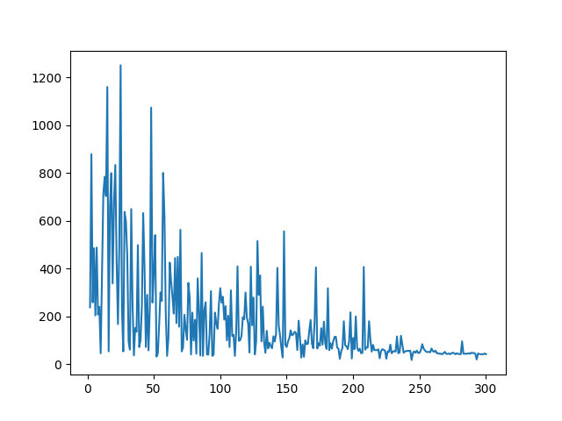
Q-LEARNING & Sarsa
Q-learning
Sarsa
rewards
steps
rewards
steps
750
950
Q-learning gets lower rewards with fewer steps.
It is brave to step into pits.
Sarsa gets higher rewards with more steps.
It scares to be punished by stepping into pits.

Slide 11
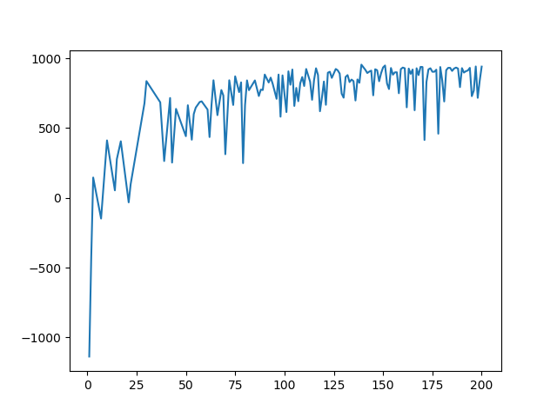
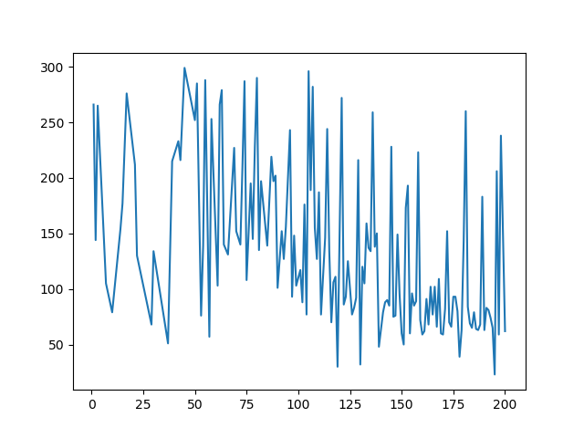
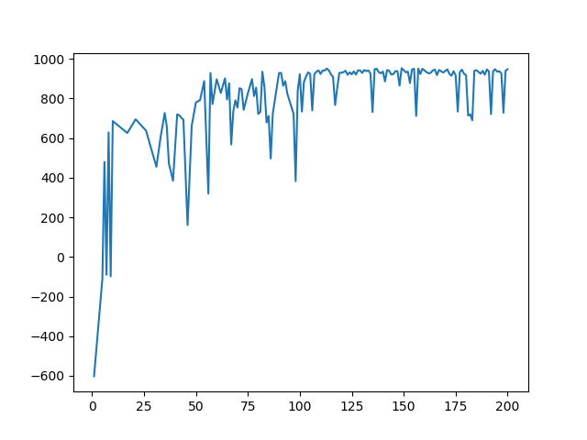
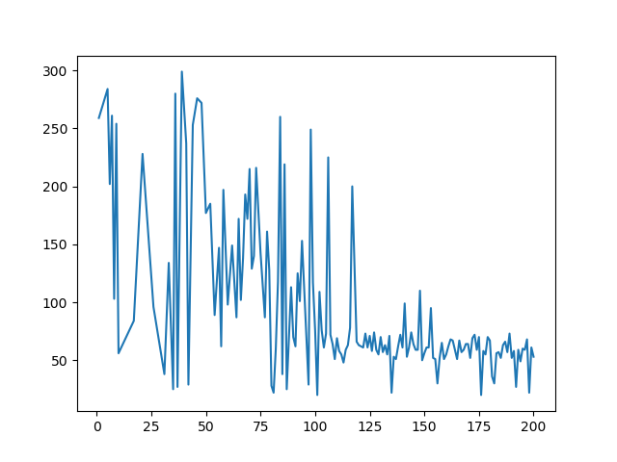
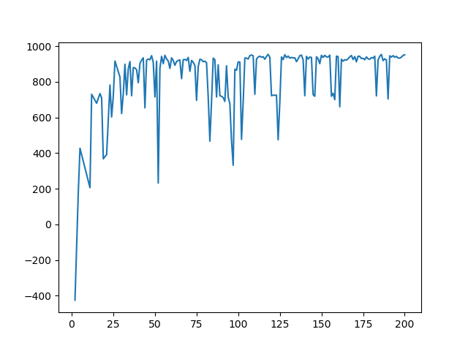
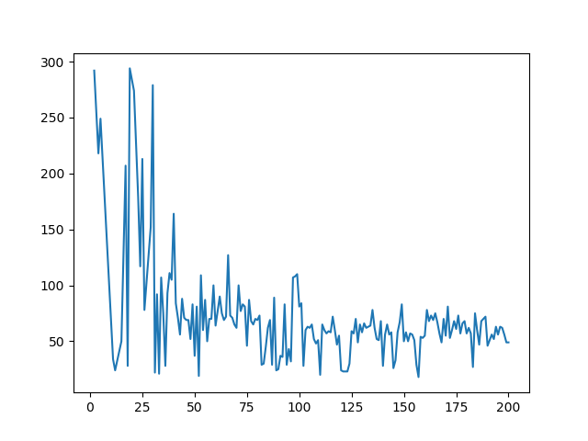
Algorithms With LAMBDA (SARSA)
1. Lambda = 0
2. Lambda = 0.5
3. Lambda = 0.8

Slide 12
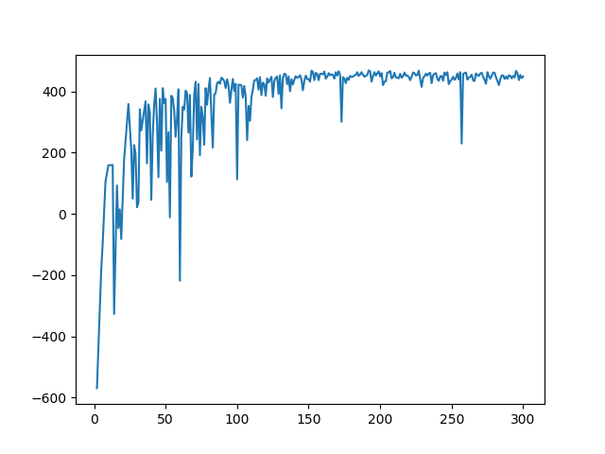
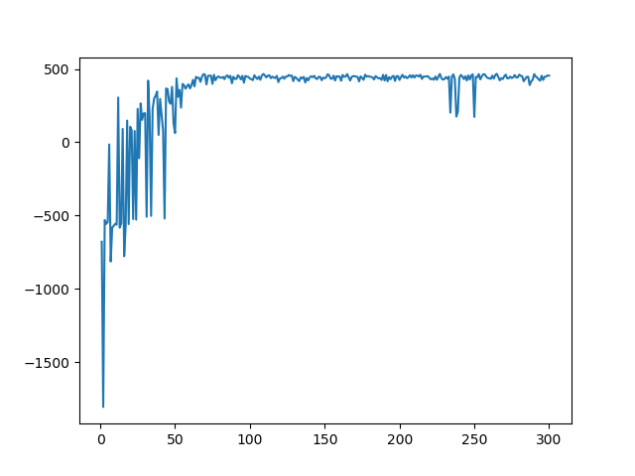
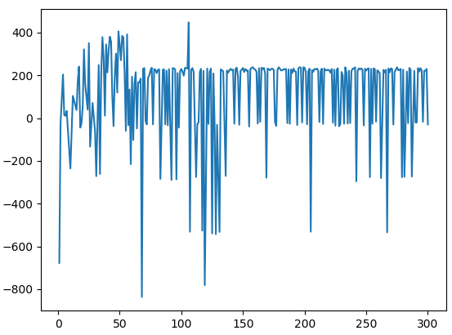
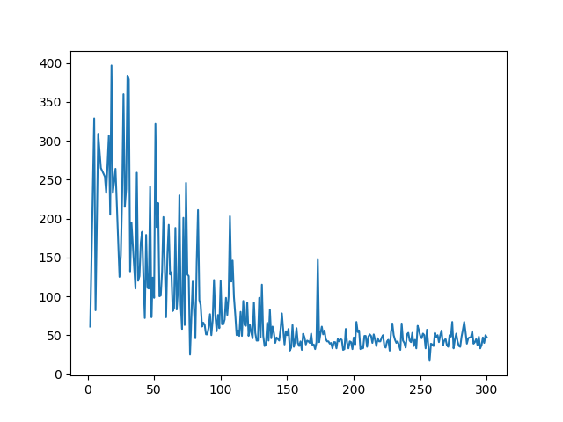
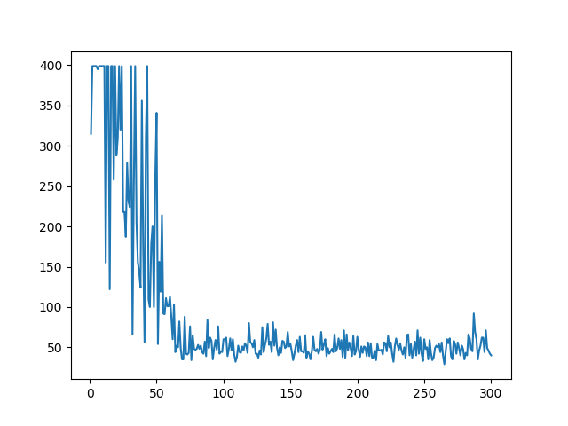
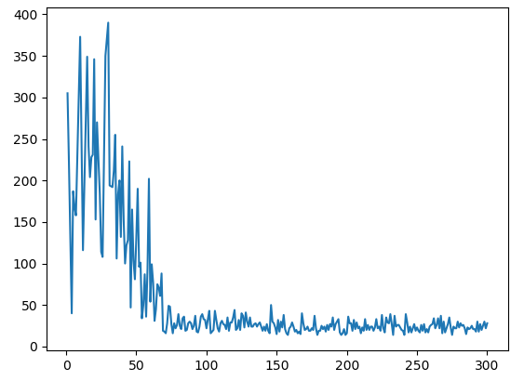
Comparision (lambda = 0.5)
Q-learning
Sarsa
QV
rewards
steps

Slide 13
To get optimal convergence (1/2)
One Q table is too simple:
Just find the rewards and go for it
Multiple rewards
Rewards are like sink, the agent not going to get larger reward behind smaller one

Slide 14
To get optimal convergence (2/2)
Multilayer of Q table:
Differentiate Q tables by extra state (with nothing, with key, with key-chest)
Dynamic greedy:
The greedy increases depending on time in training phase
Rewards and punishments of different elements
key = 0, chest = 500, exit = 500
When two rewards compete:
Store expectation (E) with maximal reward received
Proportion of current reward of E (e = r/E)
Modification of smaller reward ((e – p)/p*q)

Slide 15
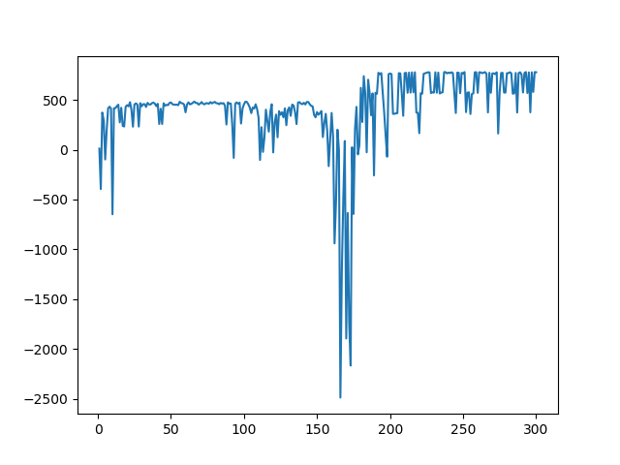
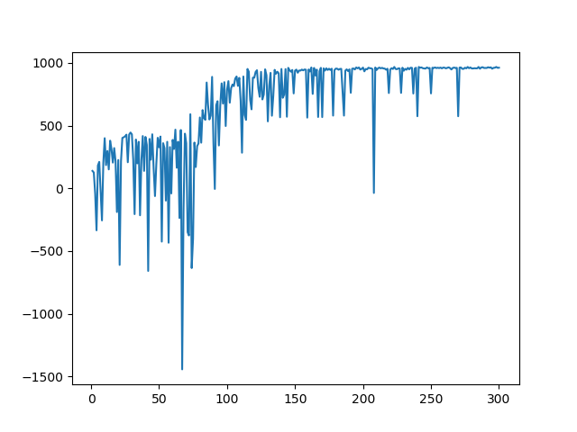
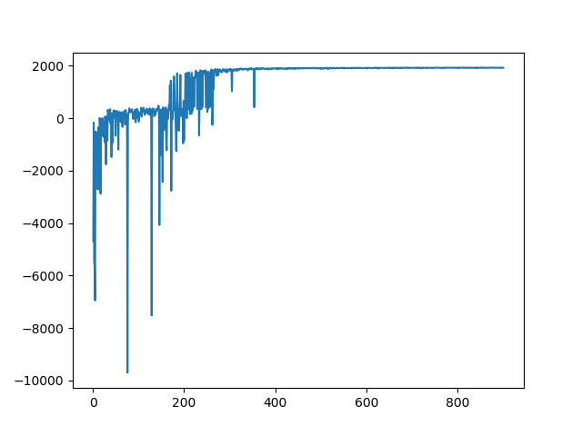
Different patterns
rewards
rewards
rewards

Slide 16
Q&A

Slide 17
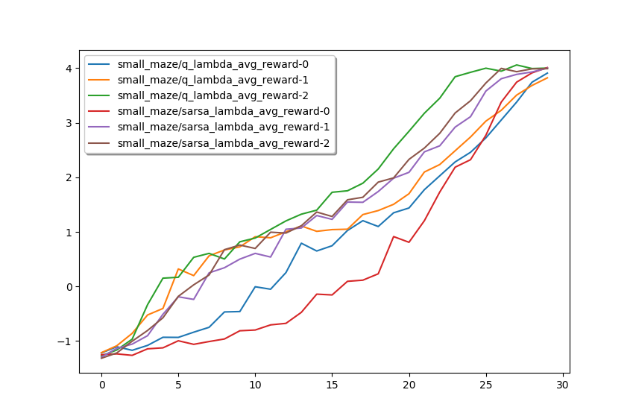

Slide 18
